Slide 1
Time Aware Health Recommendation System
PRESENTED BY : -
B.Charan-247R1A05T3
Y. Sai Abhinav- 247R1A05Z0
P. Prashanth Babu-247R1A05X6
UNDER THE GUIDANCE OF:
Dr. Bagam Laxmaiah
Professor

Slide 2
Abstract
The Time Aware Health Recommendation System is designed to provide health-related suggestions and reminders to users based on the time of the day. In today’s busy lifestyle, many people forget important health activities such as taking medicines, drinking water, eating meals on time, or following healthy routines. This system helps users maintain better health management by analyzing the current time and providing appropriate recommendations. The application can remind users about medicines, suggest healthy meals, and encourage good daily habits at the right time. By integrating simple recommendation logic with a user-friendly interface, the system aims to improve personal health awareness and support a more organized and healthier lifestyle.

Slide 3
Existing System
• Notification based reminders
• Mobile phone reminders
• Manual medicine tracking
• Calendar based reminders

Slide 4
Disadvantages of Existing System
• Users may ignore nofications reminders.
• Difficult to manage multiple medicines.
• No centralized medicine tracking.
• Lack of automated monitoring system.

Slide 5
Proposed System
• Web-based medicine reminder application.
• Users can add medicine name and schedule.
• System automatically checks time.
• Notification alerts remind users.

Slide 6
Advantages
• Simple and user friendly interface
• Automated medicine reminders
• Web based accessibility
• Helps users maintain medication discipline

Slide 7
Software Requirements
• Operating System : Windows / Linux
• Frontend Technology : React
• Programming Language : HTML ,CSS ,JavaScript and Python
• Browser : Google Chrome / Microsoft Edge

Slide 8
Novelty of the Project
• Uses browser Notification API for reminders.
• Lightweight web-based healthcare tool.
• No need for installing mobile applications.
• Provides easy medicine schedule management.

Slide 9
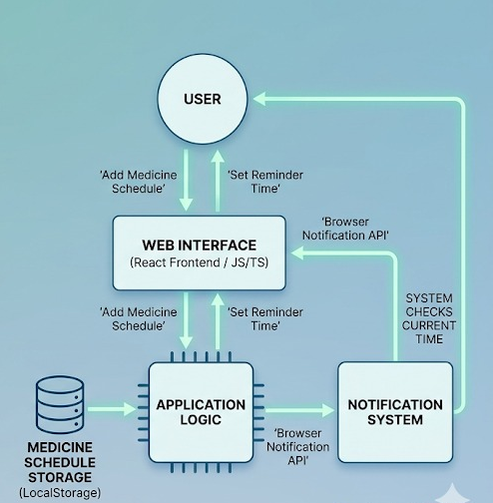
System Architecture

Slide 10
Modules
• User Interface Module
• Medicine Management Module
• Reminder Notification Module
• Settings Module

Slide 11
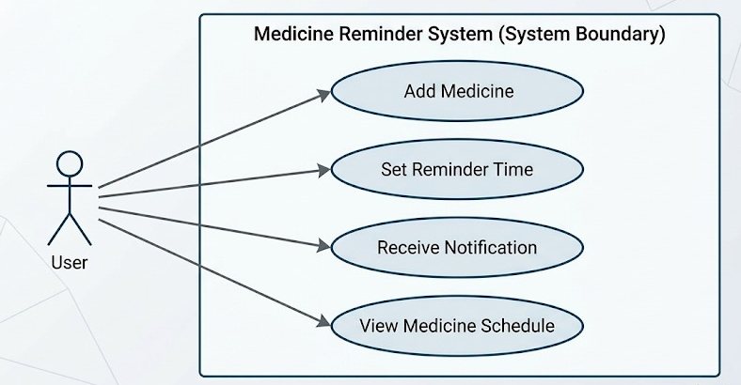
UML Diagrams – Use Case

Slide 12
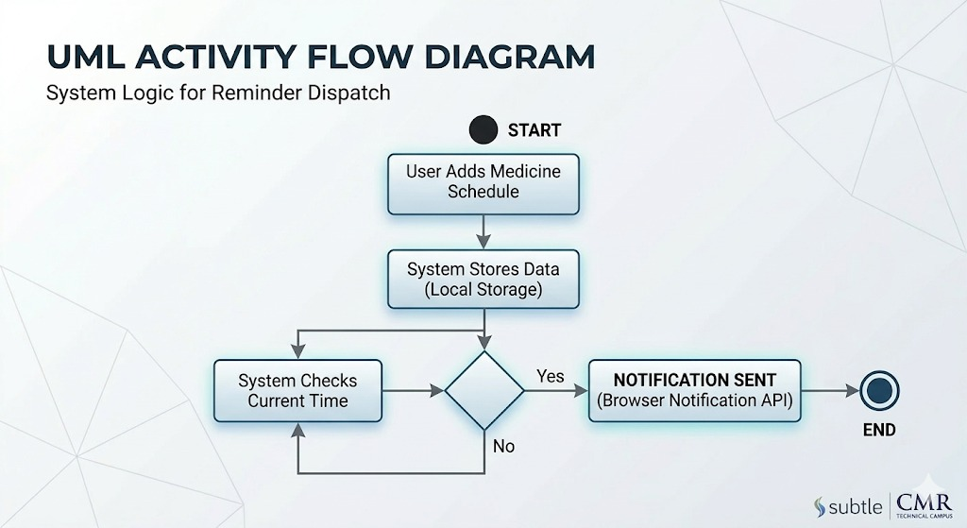
UML Diagrams – Activity Flow

Slide 13
Sample code:
import React, { useState, useEffect, useCallback, useMemo } from 'react';
import { AppState, UserProfile, Medication, Reminder, HealthInsight } from './types';
import { loadState, saveState } from './store';
import { getHealthInsights } from './geminiService';
// Pages
import Dashboard from './components/Dashboard';
import MedicationManager from './components/MedicationManager';
import Schedule from './components/Schedule';
import ProfileSetup from './components/ProfileSetup';
import Settings from './components/Settings';
import Backup from './components/Backup';
// Components
import BottomNav from './components/BottomNav';
import Header from './components/Header';
const App: React.FC = () => {
const [state, setState] = useState<AppState>(loadState());
const [currentPage, setCurrentPage] = useState<string>('dashboard');
const [insights, setInsights] = useState<HealthInsight[]>([]);
const [loadingInsights, setLoadingInsights] = useState(false);
// Persistence effect
useEffect(() => {
saveState(state);
}, [state]);

Slide 14
<div class="alert" id="alert"></div>
<form id="loginForm">
<div class="form-group">
<label for="username">Username</label>
<input type="text" id="username" name="username" required>
</div>
<div class="form-group">
<label for="password">Password</label>
<input type="password" id="password" name="password" required>
</div>
<button type="submit" class="submit-btn">Login</button>
</form>
<!DOCTYPE html>
<html lang="en">
<head>
<meta charset="UTF-8">
<meta name="viewport" content="width=device-width, initial-scale=1.0">
<title>Hospital Management - Login</title>
</head>
<body>
<div class="login-container">
<div class="login-header">
<h1>🏥 Hospital Management</h1>
<p>Secure Portal</p>
</div>

Slide 15
Future Scope:
Automated Notifications: Add real-time alerts (mobile notifications, emails) to remind users to take medicines on time.
Mobile Application Development: Develop an Android/iOS app for easy access anywhere.
AI-Based Personalization: Use Artificial Intelligence to suggest personalized medication reminders and health tips.
Multi-User Support: Allow family members or caregivers to manage medications for others.

Slide 16
CONCLUSION
The Health Alert System with Medicine Reminder helps users manage their medicine schedules effectively.
The system allows users to add medicines and set reminder times easily.
It uses browser notifications to alert users when it is time to take their medicine.
The application is simple, lightweight, and user-friendly.
This project demonstrates how web technologies can be used to improve health management.

Slide 17


